Slide 1


Salt Top Imaging
Pierce Junction Oilfield, Houston
Suleyman Coskun
AGL Research and Update Meeting
May 16, 2013

Slide 2
OUTLINE
Introduction
Study Area
Methods
  Seismic
    Data Acquisition
    Data Processing
    Results
  Gravity
    Data Acquisition
    Results
Summary

Slide 3
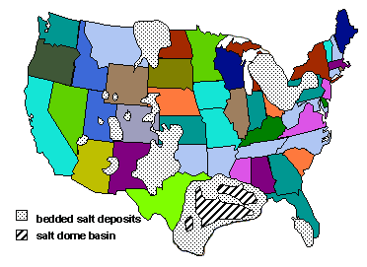
Introduction
WHY IS SALT IMPORTANT?
Significant resources remain trapped around the salt features
Salt basins have been most prospective hydrocarbon reserves
Best-Known salt Basins
  Gulf of Mexico
  West African Margins (e.g. Angola and Gabon)
  Brazilian Margins (e.g. Tupi)
About 500 salt domes exist in the U.S.
All located near or in the Gulf of Mexico
Tomasko et Al., 1999

Slide 4
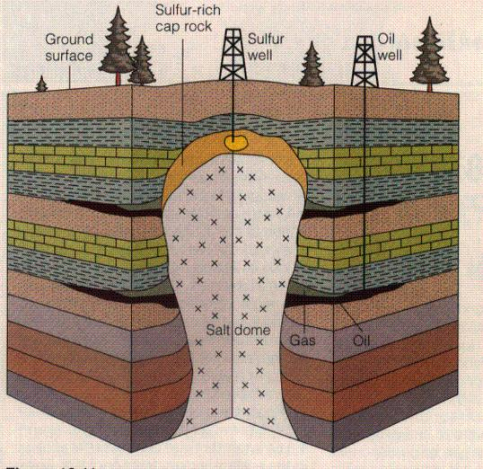
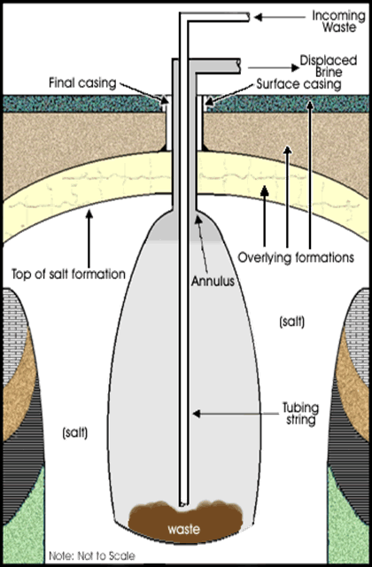
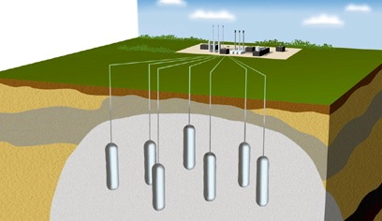
Introduction
Economic Importance of Salt Domes
Oil and Natural Gas Reservoirs
Salt Production
Underground Storage Reservoirs
Waste Disposal
A Source of Sulfur
Gas storage facility

Slide 5
Introduction
Seismic Imaging of Salt Structures
Goal: Obtain high resolution images around and below salt
  Determine accurate salt geometry
    Accurate velocity models for migration techniques
    Structural models combining gravity and magnetic data
  Engineering & Environmental Issues
    Safety regulations require a 91 m (300 feet) minimum barrier of solid salt should be maintained between the mine and surrounding material
    Location of the upper limits of the salt dome for surface related construction projects

Slide 6
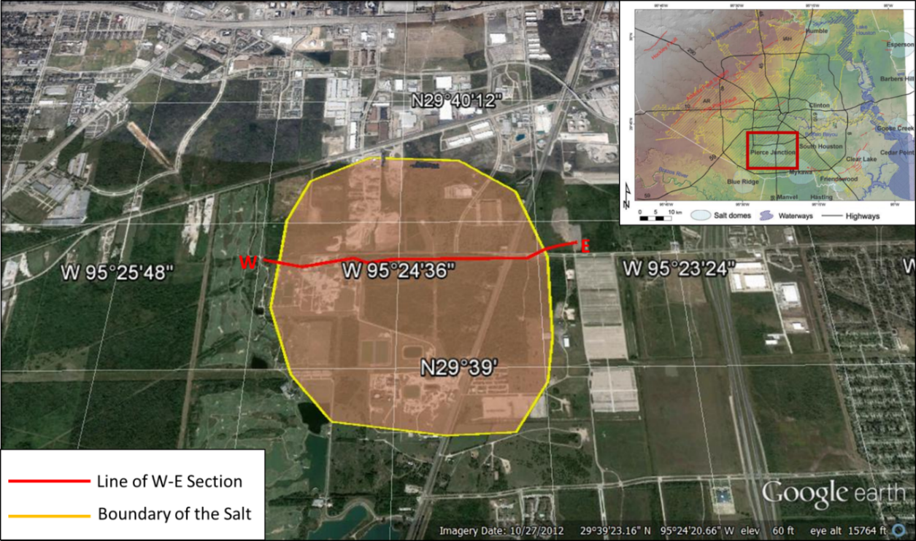
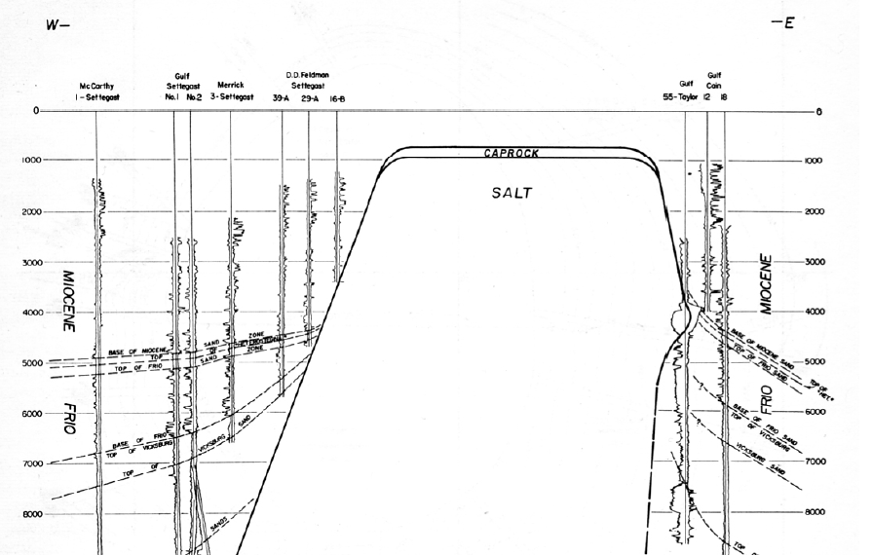
Study AREA
PIERCE JUNCTION SALT DOME
Two miles south of Houston
One of the most prolific fields in Texas with more than 150 producing wells
First production made in 1921 by South Texas Petroleum Company owned by Hugh Roy Cullen
Overlying Cap Rock: 207 m
Top of the Salt: 262 m
(Backman and Williamson,1990)
Oil Accumulations have been found on the flanks of the structure in each stratigraphic unit from through the Jackson formations
Produced over 104 million barrels of oil from Miocene, Frio, and Vicksburg reservoirs
288
Modified from Golden Gate Ltd. Report, 2012; Engelkemeir and Khan, 2007
Glass,1953

Slide 7
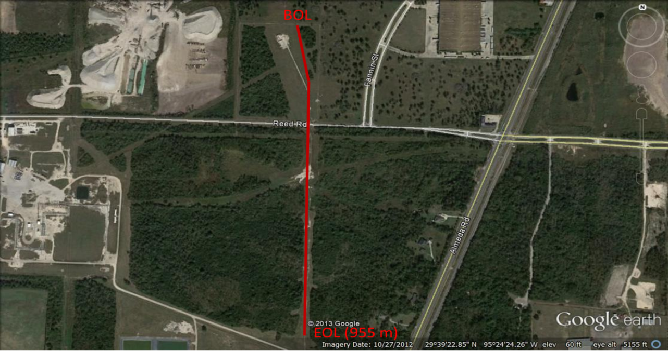
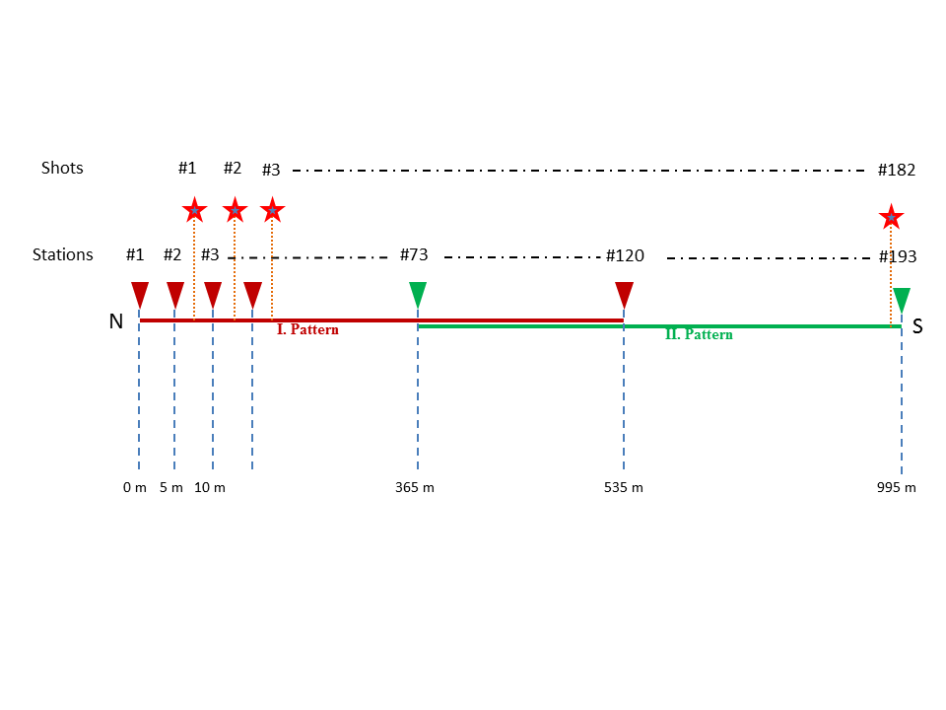
Seismic Data acquisition
Energy Source | MiniVibe - Vertical
Sweep Length | 12 sec
Sweep Type / Frequency | Linear /10-120 Hz
Vertical Stack | 3
Shot Interval | 5 m
Number of Shots | 182
Receiver | Geospace 14 Hz
Number of Geophones | 120 V – 120 H
Receiver interval | 5 m
Recording Length | 4 sec
Sampling Interval | 1 ms

Slide 8
Seismic DATA PROCESSING vertical component
Geometry Loading
Separated Vertical and Radial Components
Trace Editing
Edited Noisy & Bad Traces
Static Correction
Velocity determined by first break picking
Band Limited Noise Suppression
3-20 Hz Frequency Band Noise Suppression
Velocity Analysis
Time-Frequency Domain Spectral Balancing
Kirchhoff Pre-stack Time Migration
Stack
Time-Frequency Noise Suppression

Slide 9
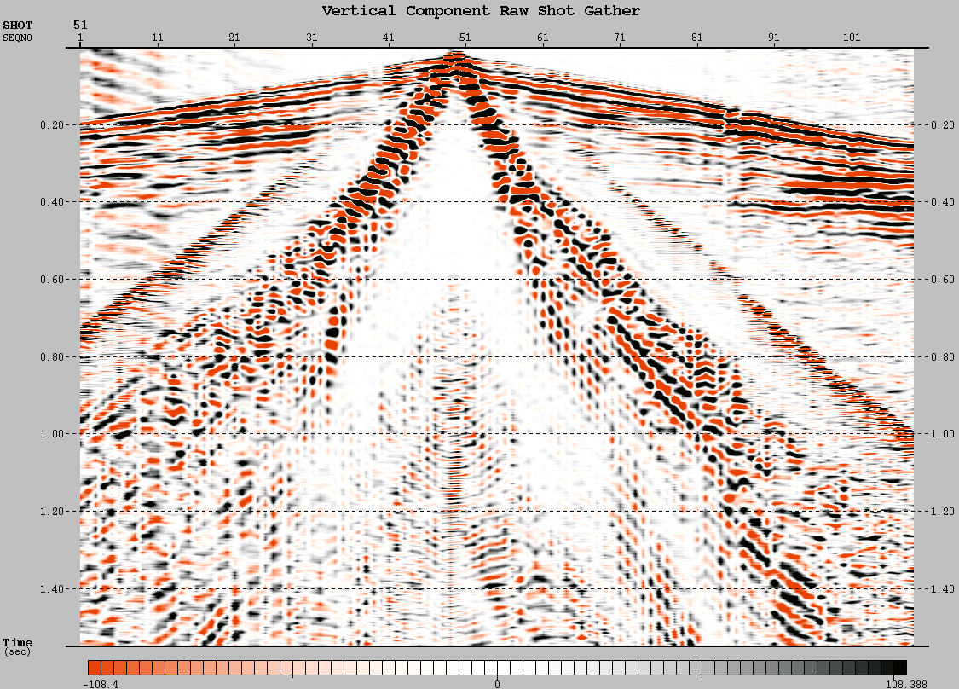
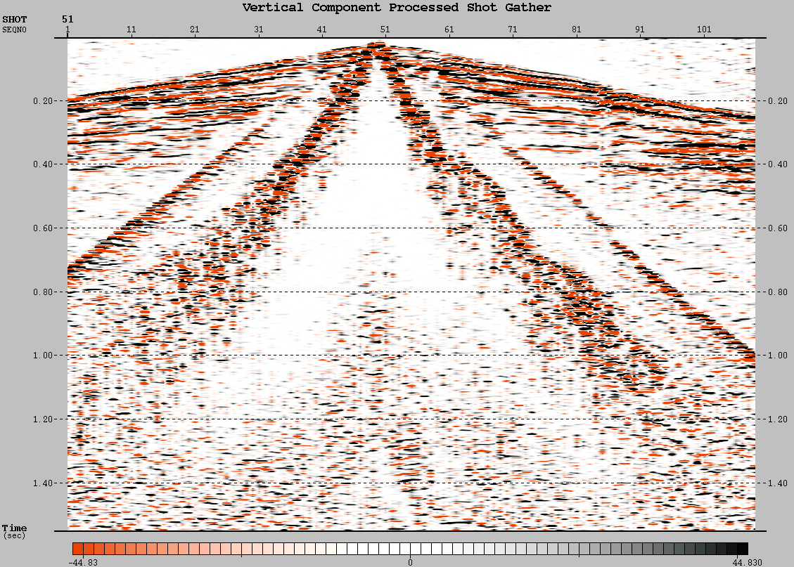
Seismic DATA PROCESSING vertical component

Slide 10
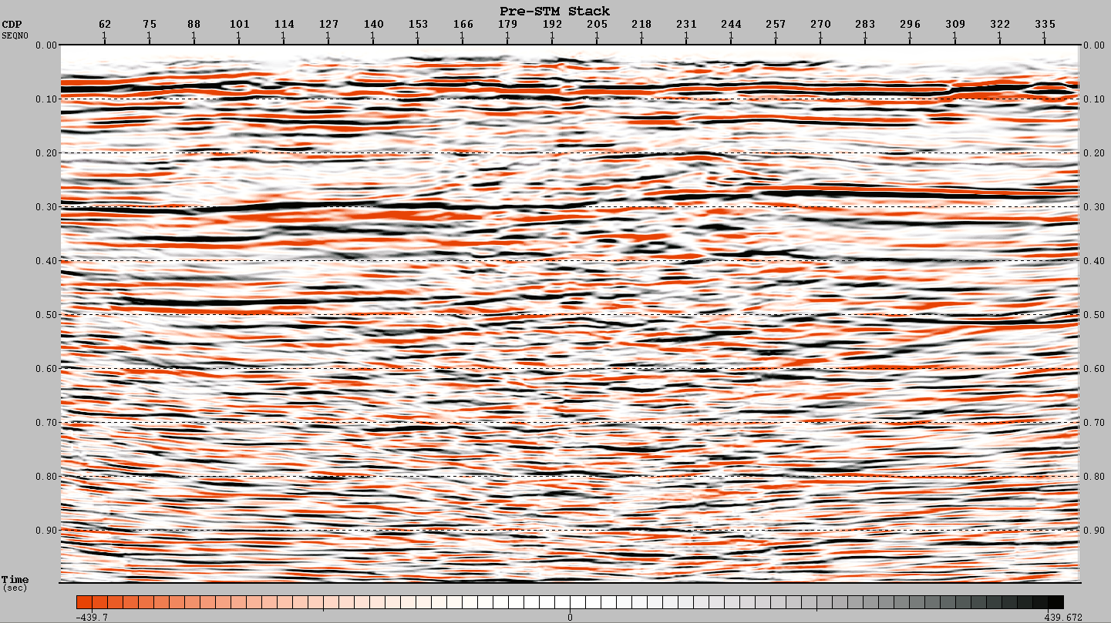
Seismic DATA PROCESSING
vertical component
Cap rock
Top of the salt

Slide 11
Seismic DATA PROCESSING
Radial component
Geometry Loading
Separated Vertical and Radial Components
Trace Editing
Edited Noisy & Bad Traces
Polarity Reversal
Band pass Filter
Gamma Analysis
CCP Non-Hyperbolic Move Out Correction
Common Converted Point Binning
(CCP Binning)
Stack
Gamma: 1,5
20-25-80-90 Frequency band

Slide 12
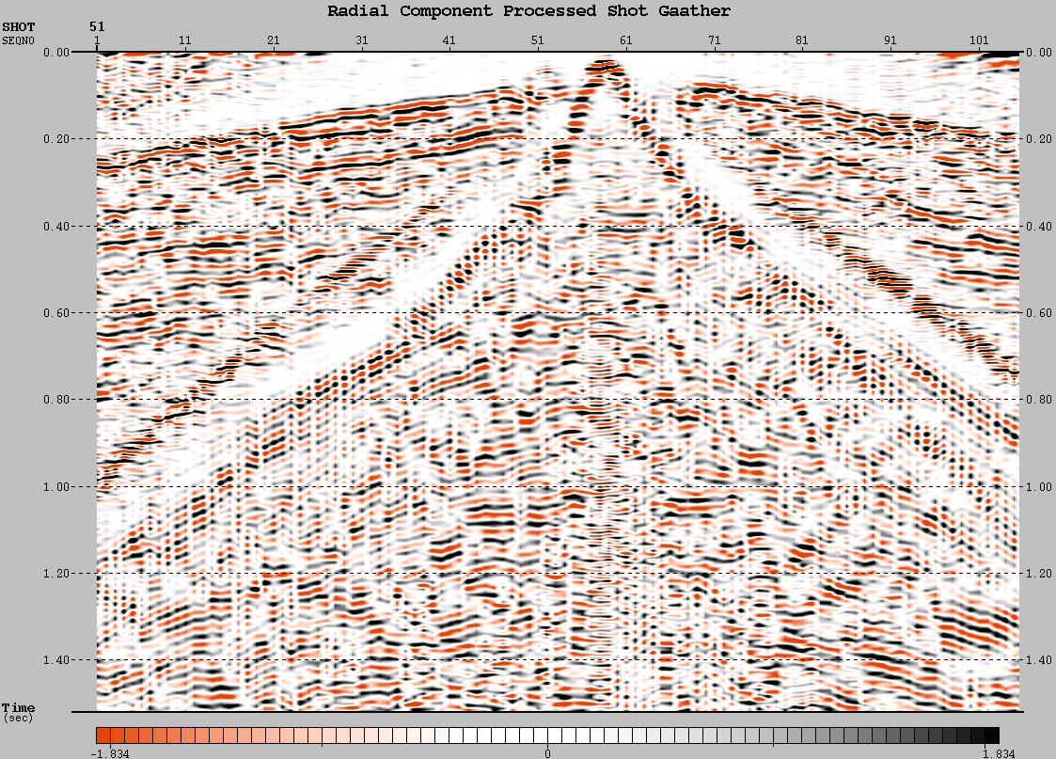
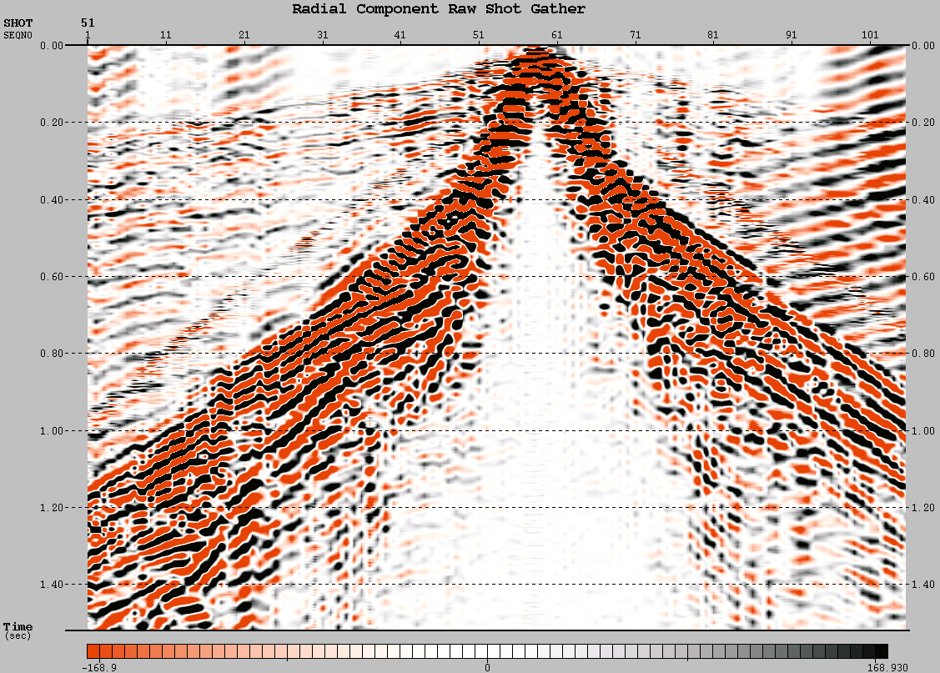
DATA PROCESSING
Radial component

Slide 13
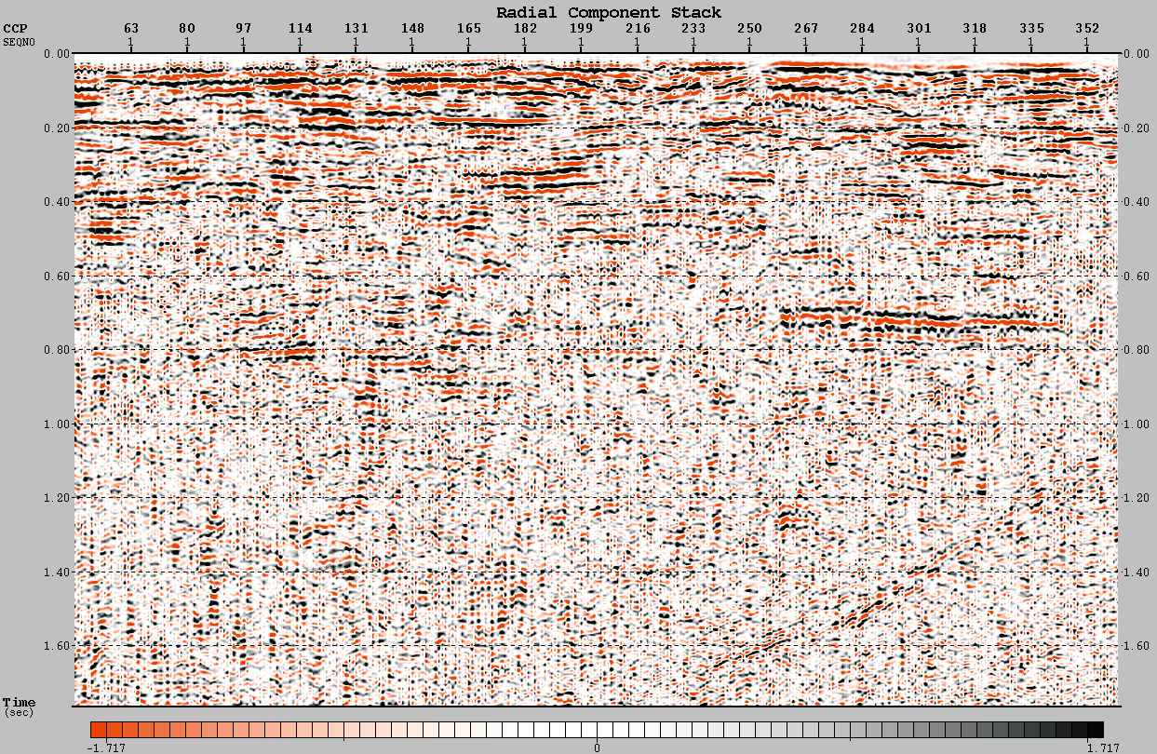
DATA PROCESSING
Radial component
Cap rock ???
Top of the salt???

Slide 14
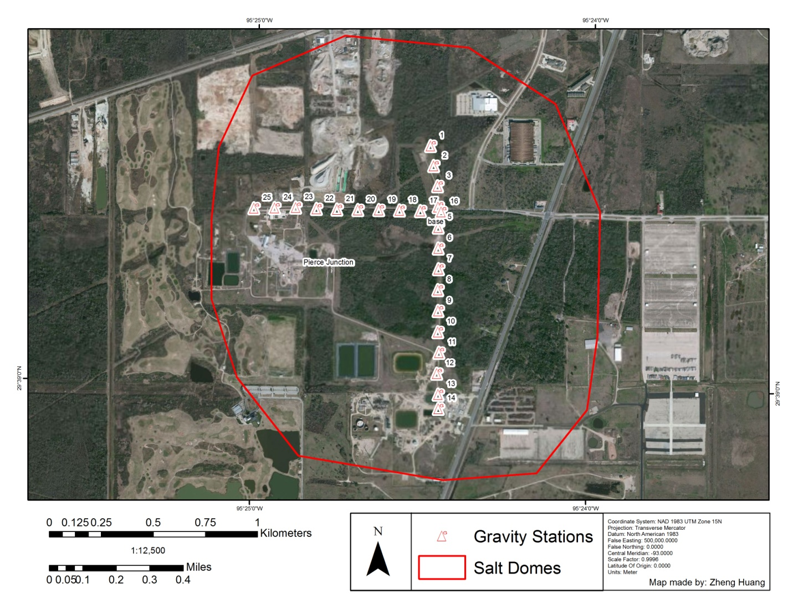
GRAVITY Data acquisition
Gravimeter | Scintrex CG-5 Autograv
GPS Receiver | Trimble 5700
Survey Controller | Trimble TSC 2
Line Direction | N-S
Number of Stations | 14
Station Interval | 100 m
Base Station Number | 4
Line Direction | E-W
Number of Stations | 9
Station Interval | 100 m
Base Station Number | 16
First Dataset | May 5, 2011
Second Dataset | September 28, 2011
Huang, Z.Y.(2012)

Slide 15
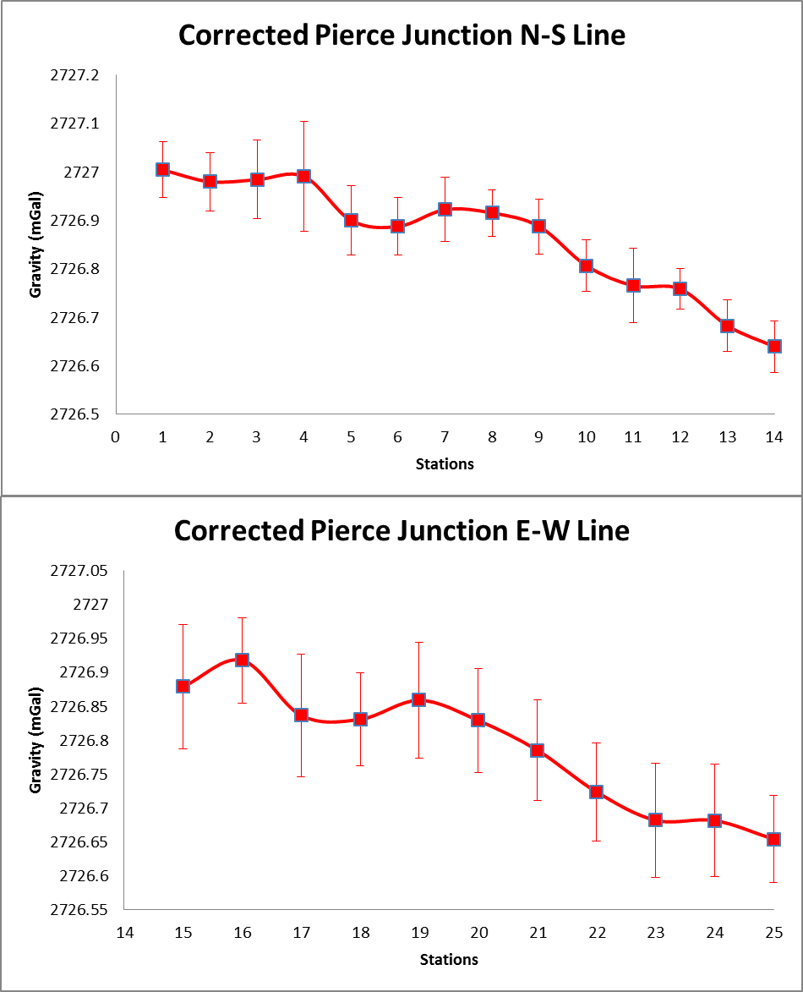
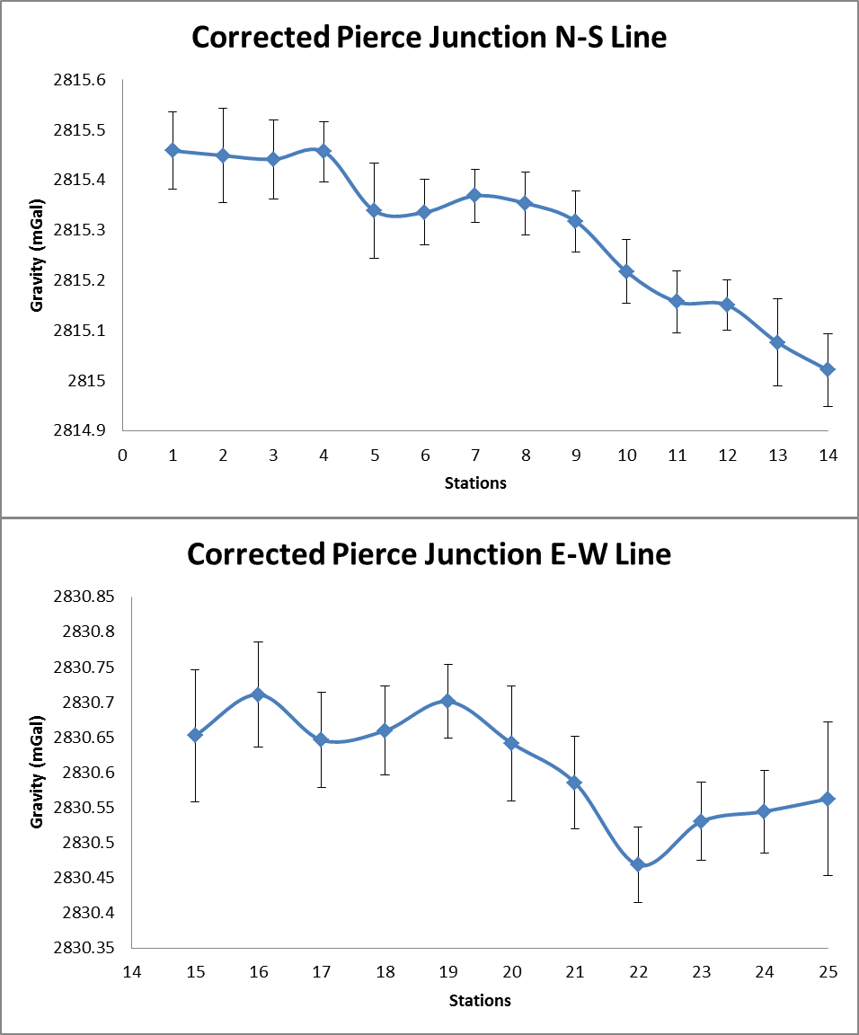
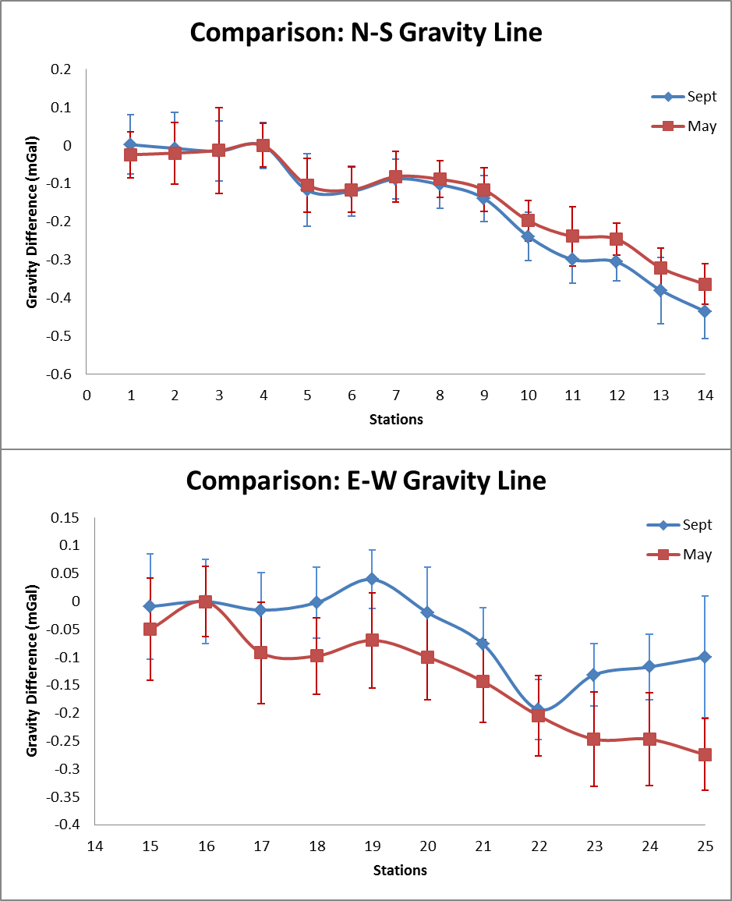
GRAVITY Data acquisition
Base stations selected on the estimated center of salt dome by using Digital Elevation Models (Engelkeimer, 2008)
Higher gravity readings at estimated center of domes
Lower Gravity readings North to South, East to West
Possible Reasons for Gravity Difference
  Subsurface salt movement
    0.08 mGal difference may show a uniform rise from N,S,E,W
  Water level change between two scanning periods
  Variability in the field acquisition
More variability between two scanning periods in E-W line
N-S Gravity Difference
  May 2011: 0.36 mGal
  September 2011: 0.44 mGal
E-W Gravity Difference
  May 2011: 0.27 mGal
  September 2011: 0.19 mGal
September 2011
May 2011
Huang, Z.Y.(2012)

Slide 16
Summary
2D/2C Seismic (955 m) and gravity data are collected in Pierce Junction salt dome area
Both vertical and radial component data were processed and interpreted
  Vertical data; cap rock and salt reflectors are determined at 205m and 290 m, respectively
  Radial component data; proposed reflectors at 500 ms and 750 ms. Further processing is in progress
Gravity differences are observed between two scanning periods
  Attributed to subsurface salt movement, changes in water level, or field acquisition procedures

Slide 17
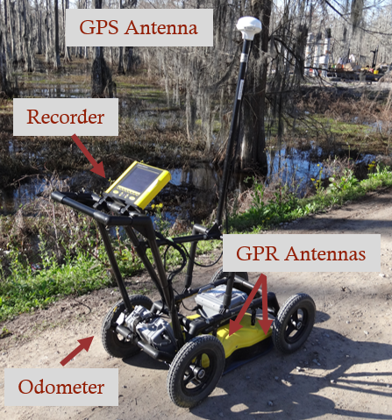
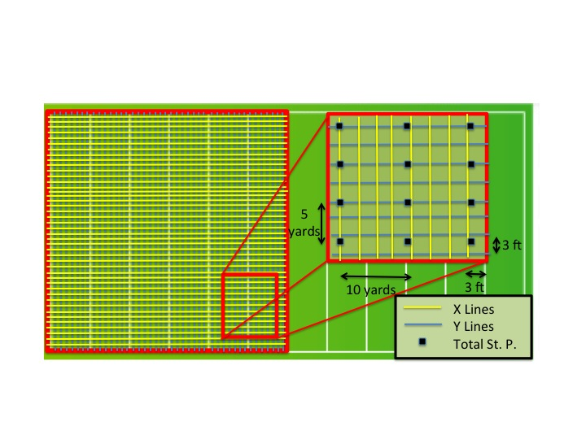

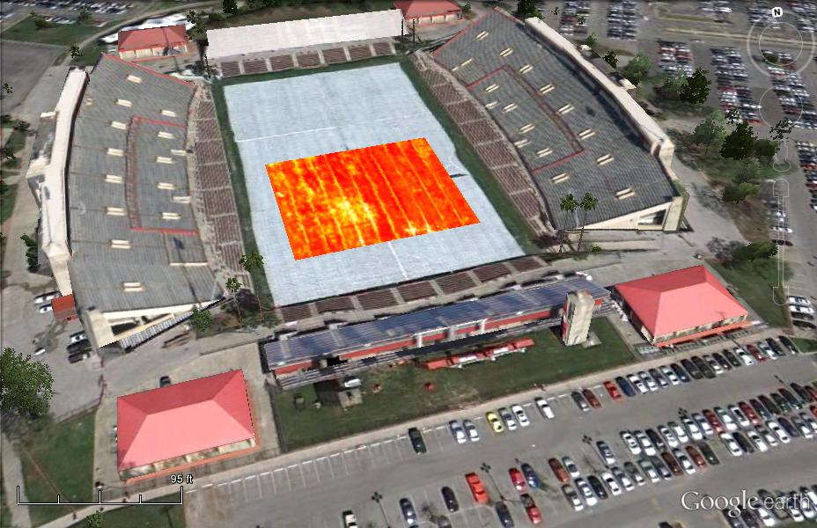
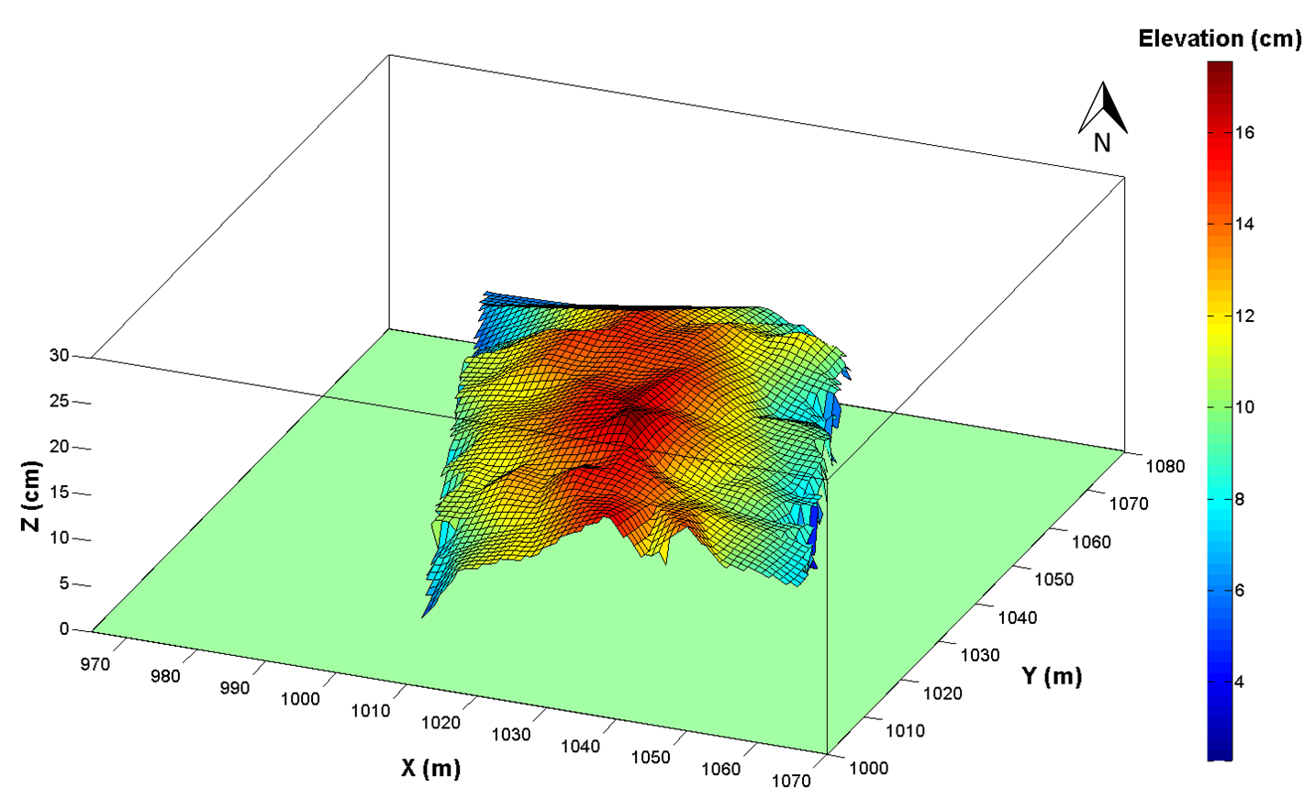
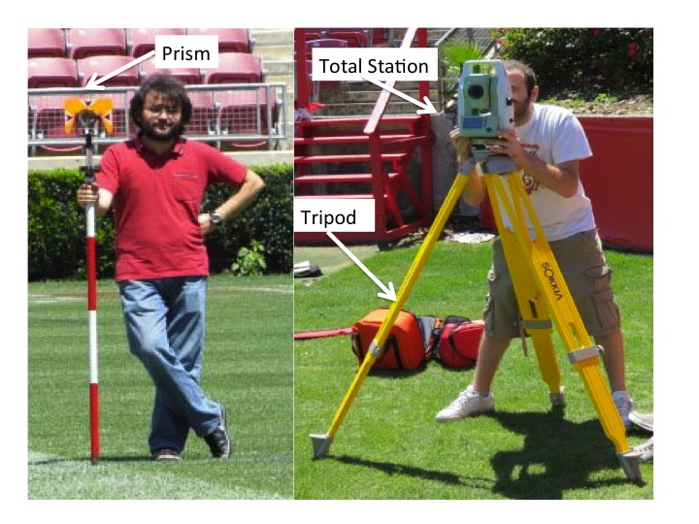
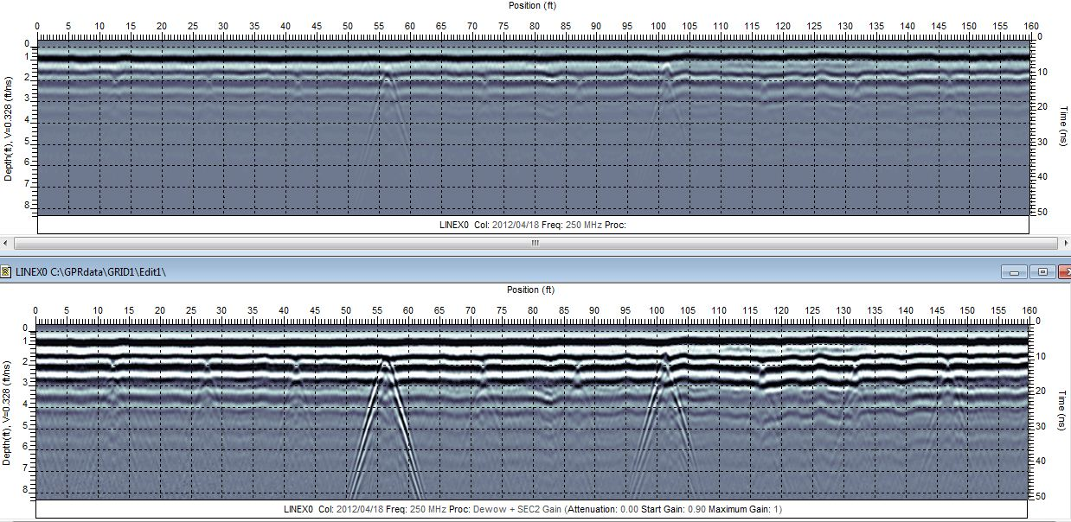
Near Surface Mapping of Robertson Stadium Football Field using GPR Method

Slide 18

THANK YOU
We would like to thank Texas Brine Company for providing this valuable study
Seismic data is processed by Paradigm’s Echos software
References:
Beckman, J. D. and A. K. Williamson (1990). Salt-Dome Locations in the Gulf Coastal Plain, South-Central United States. Water-Resources Investigations Austin, U.S. Geological Survey: 1-47
Engelkemeir, R and Khan, S (2007). Near-surface Geophysical Studies of Houston Faults. The Leading Edge 26(8): 1004-1008
Glass, C. N. (1953). Pierce Junction Filed Harris County, Texas. Guidebook, Field Trip Routes. Oil Fields, Geology, Houston Geological Society: 147-150.
Huang, Z.Y.(2012). Multi disciplinary Investigation Of Surface Deformation Above Salt Domes In Houston, Texas. Master Thesis, University of Houston

